Slide 1
Rational Functions
Algebra 2
Chapter 7

Slide 2
This Slideshow was developed to accompany the textbook
  Big Ideas Algebra 2
  By Larson, R., Boswell
  2022 K12 (National Geographic/Cengage)
Some examples and diagrams are taken from the textbook.
Slides created by
Richard Wright, Andrews Academy
rwright@andrews.edu

Slide 3
7.1 Inverse Variation
After this lesson…
• I can identify equations and data sets that show direct variation.
• I can identify equations and data sets that show inverse variation.
• I can write inverse variation equations.
• I can solve real-life problems using inverse variation functions.

Slide 4

7.1 Inverse Variation
Direct Variation: y = ax
  x ↑, y ↑
Inverse Variation: $y=\frac{a}{x}$
  x ↑, y ↓
a
is the constant of variation

Slide 5

7.1 Inverse Variation
What type of variation is each of the following?
  xy = 48
  2y = x
  y = 2x + 3
  Try 359#1
  $y=\frac{2}{x}$
Notes:
y = 48 / x → inverse
y = ½ x → direct
+3 means neither
359#1: inverse

Slide 6
7.1 Inverse Variation
Checking data for variation
  Look at the y-values
    If y increases as x increases, check direct variation
    If y decreases as x increases, check inverse variation
  Plug each of the data points in one of the variation equations to find a
  If the a stays the same, the data has that type of variation
What type of variation?
Try 359#9
x | 2 | 4 | 8
y | 8 | 4 | 2
Notes:
y decreases as x increases, check inverse variation
$$y=\frac{a}{x}→xy=a$$
(2, 8) → xy = 2(8) = 16
(4, 4) → xy = 4(4) = 16
(8, 2) → xy = 8(2) = 16
359#9: direct

Slide 7
7.1 Inverse Variation
Solving Variations
  Write the equation in order stated.
    “Varies” means “= a”
  Plug in x and y to find a
  Plug in a and the other value and solve
359#15: y varies inversely as x. When x = −3, y = 8. Write an equation relating x and y. Then find y when x = 3.
Try 359#13
y varies inversely as x. When x = 5, y = −4. Write an equation relating x and y. Then find y when x = 3.
Notes:
$$y=\frac{k}{x} → 8=\frac{k}{−3} → −24=k$$
$$y=−\frac{24}{x}$$
$$y=\frac{−24}{3} → y=−8$$
359#13: $y=−\frac{20}{x}$; $y=−\frac{20}{3}$

Slide 8
7.1 Inverse Variation
The time t (in hours) that it takes a group of roofers to roof a house varies inversely with the number n of roofers. It takes a group of 4 roofers 9 hours to roof the house. How long does it take 6 roofers to finish the house?
Try 359#26
359 #1-25 odds, 26, 31, 35, 39, 45, 47, 49
Notes:
$$t=\frac{a}{n}$$
$$9=\frac{a}{4}$$
$$a=36$$
$$t=\frac{36}{n}$$
$$t=\frac{36}{6}=6 hour$$
$$P=\frac{k}{A}$$
$$0.43=\frac{k}{360}→154.8=k$$
$$P=\frac{154.8}{A}$$
$$P=\frac{154.8}{60}=2.58$$

Slide 9
7.2 Graphing Rational Functions
After this lesson…
• I can graph rational functions.
• I can describe transformations of rational functions.
• I can explain how to find the asymptotes of a rational function from an equation.
• I can write rational functions in different forms.

Slide 10
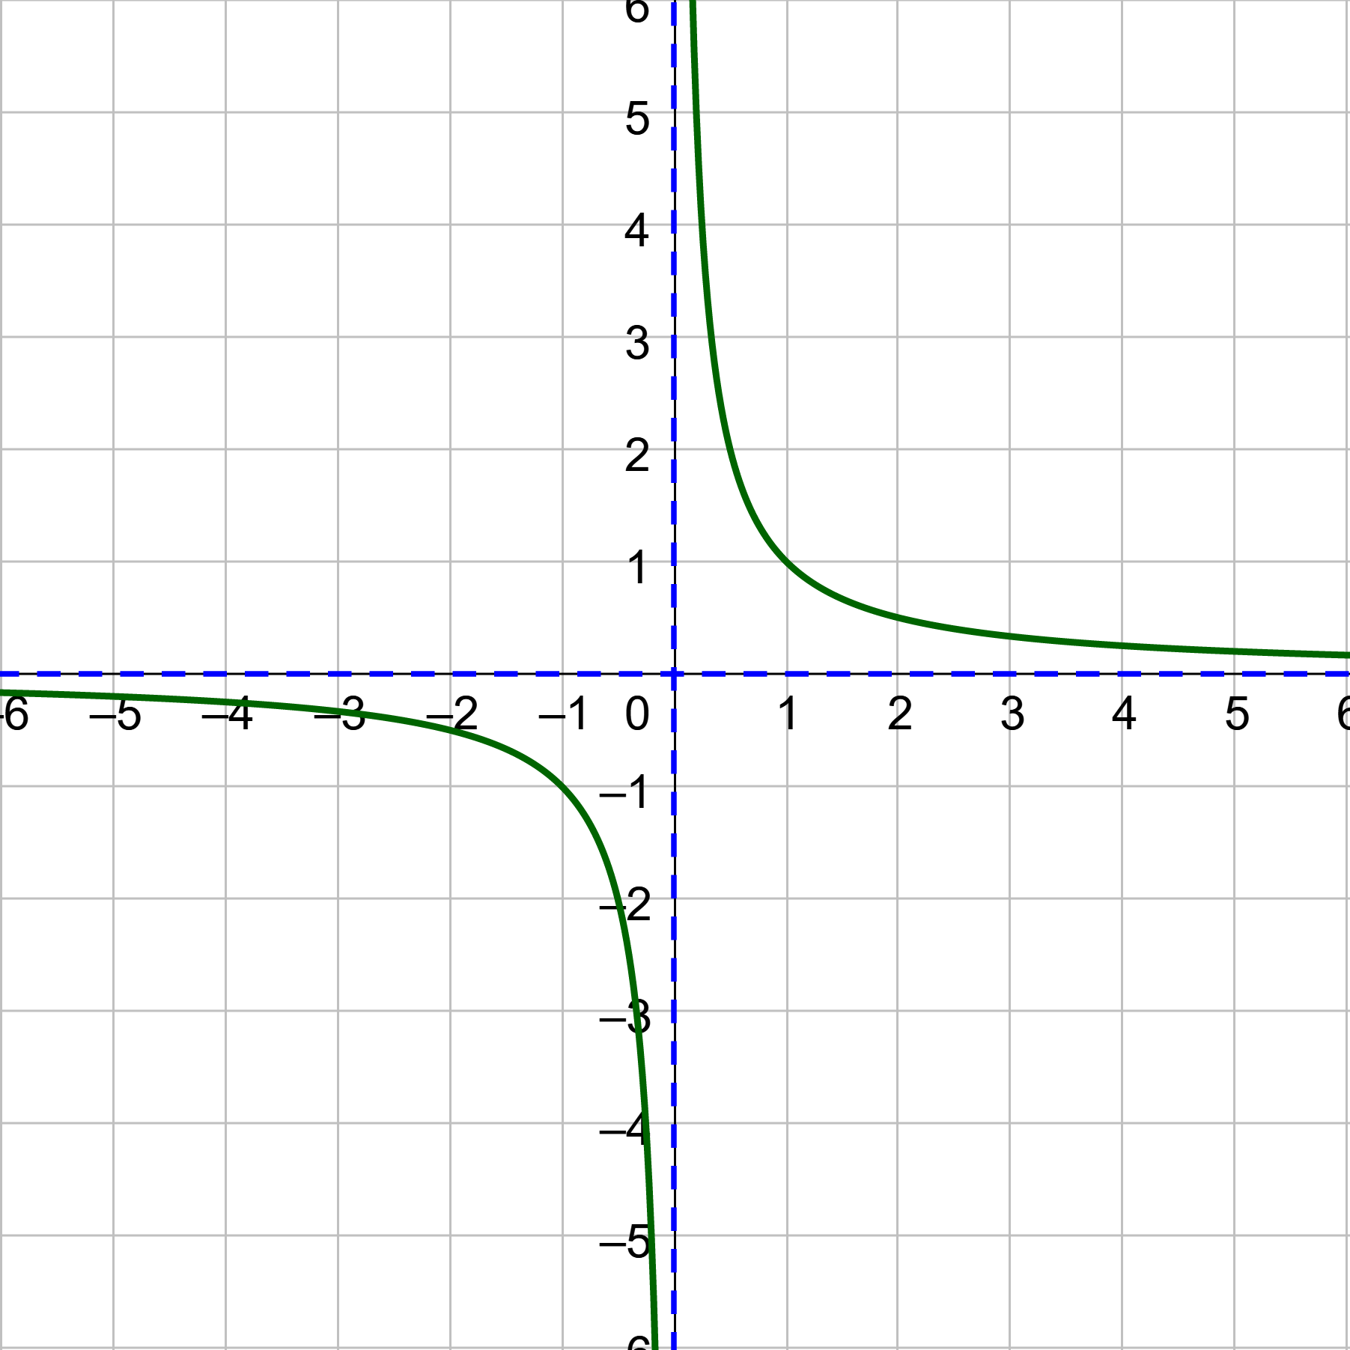
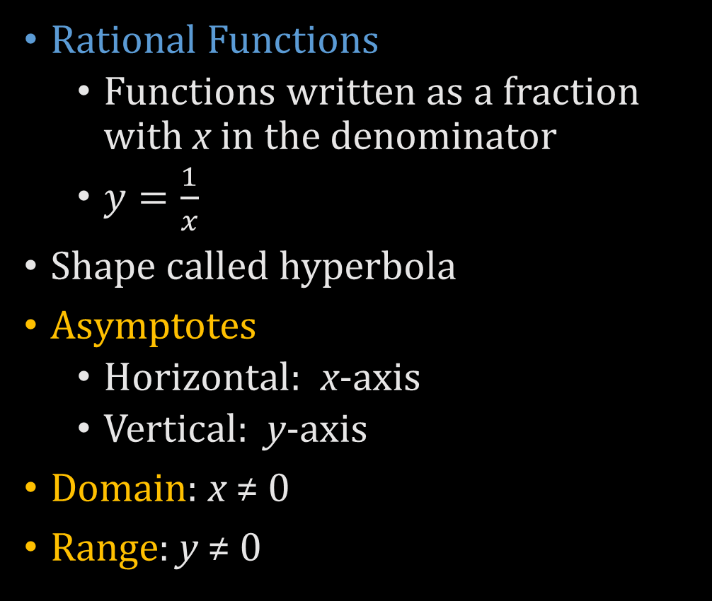
7.2 Graphing Rational Functions
Rational Functions
  Functions written as a fraction with x in the denominator
  $y=\frac{1}{x}$
Shape called hyperbola
Asymptotes
  Horizontal: x-axis
  Vertical: y-axis
Domain: x ≠ 0
Range: y ≠ 0

Slide 11

7.2 Graphing Rational Functions
General form
  $y=\frac{a}{x−h}+k$
    a → stretches vertically
    h → moves right
    k → moves up
How i$s y=\frac{2}{x+3}+4$ transformed from $y=\frac{1}{x}$?
Notes:
Stretches vertically by factor of 2
Moves left 3
Moves up 4

Slide 12
7.2 Graphing Rational Functions
How to find asymptotes
  Vertical
    Make the denominator = 0 and solve for x

Slide 13
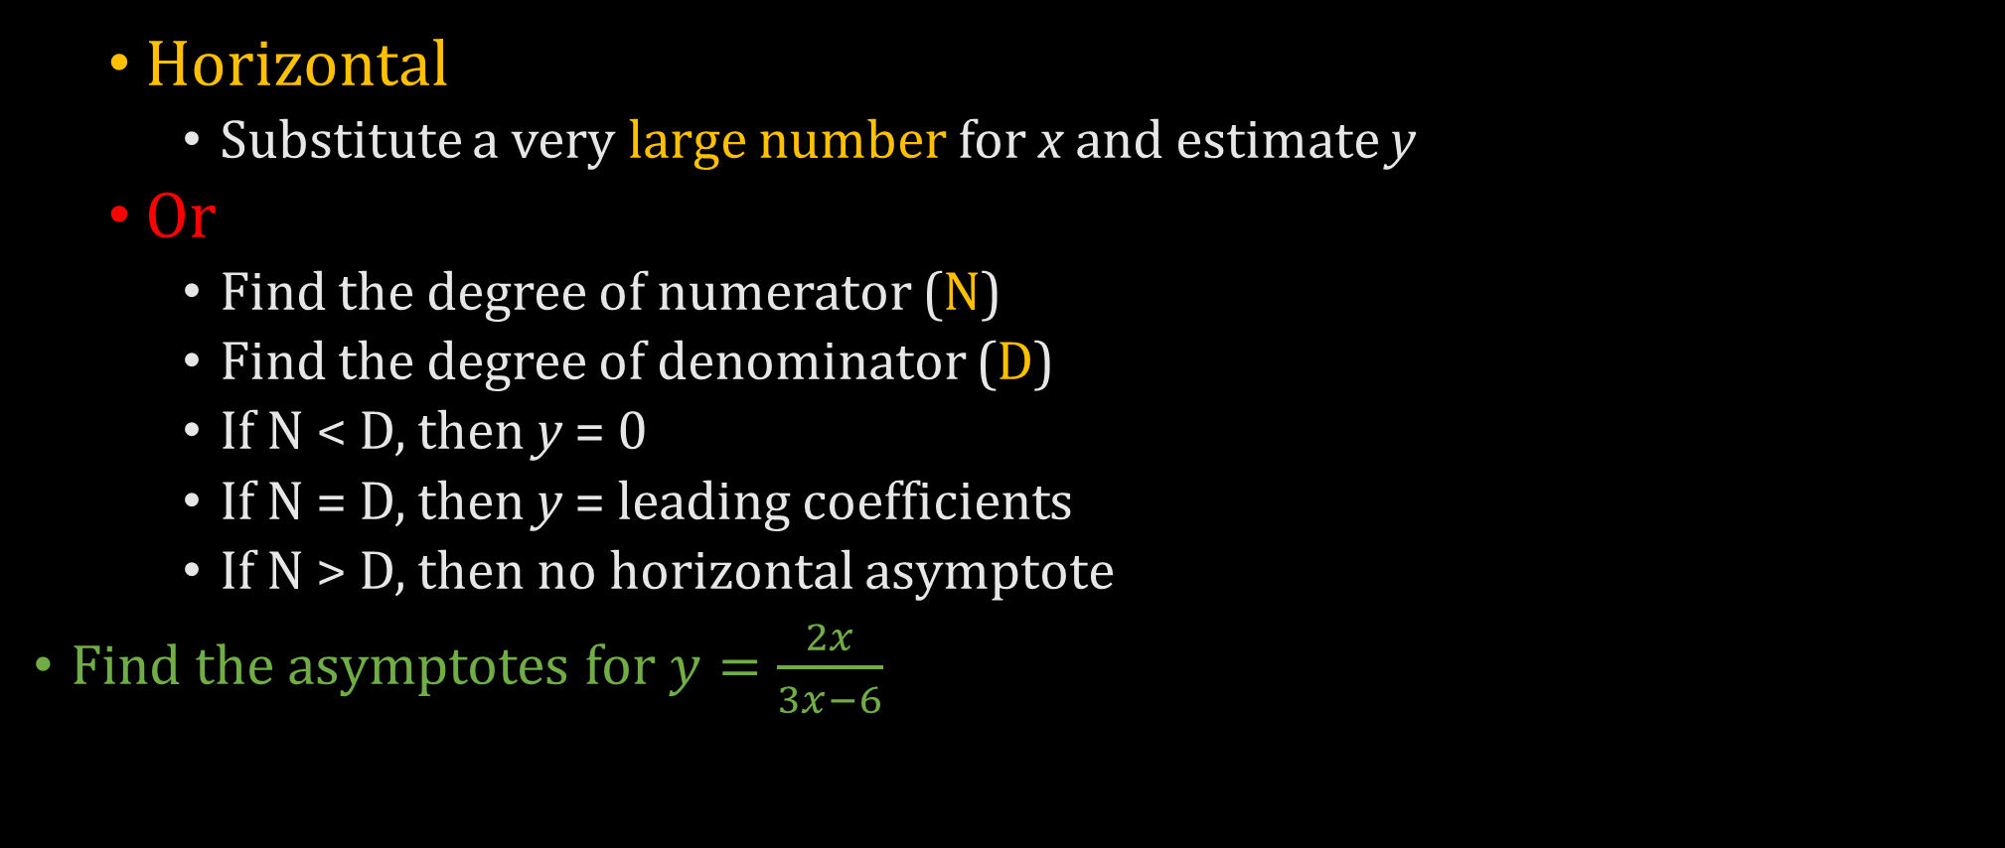
7.2 Graphing Rational Functions
  Horizontal
    Substitute a very large number for x and estimate y
  Or
    Find the degree of numerator (N)
    Find the degree of denominator (D)
    If N < D, then y = 0
    If N = D, then y = leading coefficients
    If N > D, then no horizontal asymptote
Find the asymptotes for $y=\frac{2x}{3x−6}$
Notes:
Vertical: $3x−6=0 → 3x=6 → x=2$
Horizontal: $y=\frac{2·1000000}{3·1000000−6}→ y=\frac{2}{3}$

Slide 14
7.2 Graphing Rational Functions
Domain
  All x’s except for the vertical asymptotes
Range
  All the y’s covered in the graph
  Usually all y’s except for horizontal asymptote

Slide 15

7.2 Graphing Rational Functions
Graph by finding asymptotes and making a table
Graph $y=\frac{2}{x+3}+4$ and state the domain and range
Try 366#9: $g\left(x\right)=\frac{4}{x}+3$
Notes:
Asymptotes
Vertical: x + 3 = 0 → x = −3
Horizontal: $y=\frac{2}{1000000 + 3}+4→ y=4$
Domain: x≠−3
Range: y≠4
Asymptotes:
Vertical: x = 0
Horizontal: $y=\frac{4}{1000000}+3≈y= 3$
Domain: x ≠ 0
Range: y ≠ 3

Slide 16

7.2 Graphing Rational Functions
Rewrite $g\left(x\right)=\frac{2x+5}{x+2}$ in the form $g\left(x\right)=\frac{a}{x−h}+k$. Graph the function. Describe the graph of g as a transformation of the graph of $f\left(x\right)=\frac{a}{x}$.
Notes:
Synthetic or Long Division
-2 | 2 5
-4
-2 | 1
$$g\left(x\right)=−2+\frac{1}{x+2}=\frac{1}{x+2}−2$$
Domain: x≠−2
Range: y≠−2

Slide 17
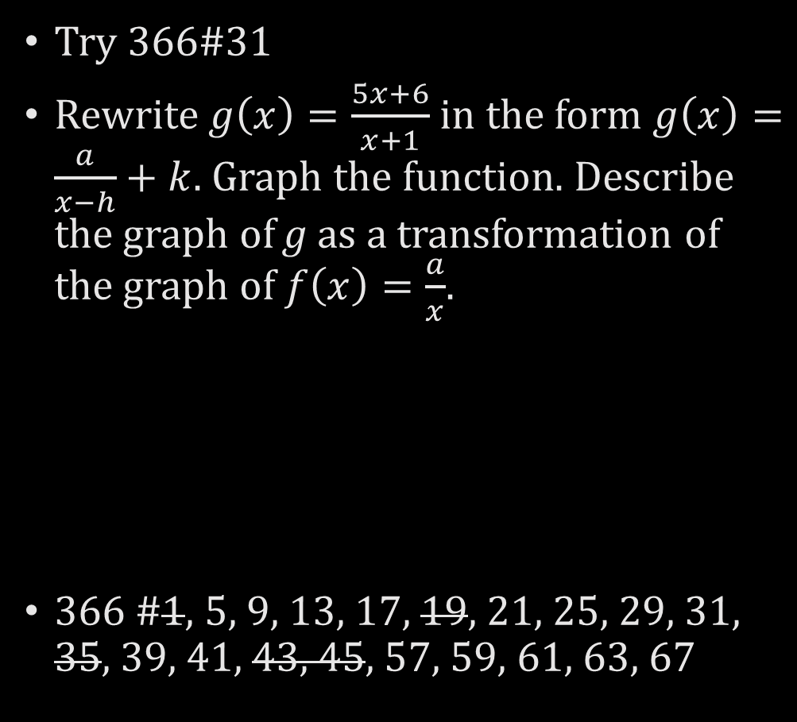
7.2 Graphing Rational Functions
Try 366#31
Rewrite $g\left(x\right)=\frac{5x+6}{x+1}$ in the form $g\left(x\right)=\frac{a}{x−h}+k$. Graph the function. Describe the graph of g as a transformation of the graph of $f\left(x\right)=\frac{a}{x}$.
366 #1, 5, 9, 13, 17, 19, 21, 25, 29, 31, 35, 39, 41, 43, 45, 57, 59, 61, 63, 67
Notes:
Synthetic or Long Division
-1 | 5 6
-5
5 | 1
$$g\left(x\right)=5+\frac{1}{x+1}=\frac{1}{x+1}+5$$
Domain: x≠−1
Range: y≠5

Slide 18
7.3 Multiplying and Dividing
Rational Expressions
After this lesson…
• I can simplify rational expressions and identify any excluded values.
• I can multiply rational expressions.
• I can divide rational expressions.

Slide 19
7.3 Multiplying and Dividing
Rational Expressions
Simplified form
  Numerator and denominator can have no common factors
Steps to simplify
  Factor numerator and denominator
  Cancel any common factors

Slide 20


7.3 Multiplying and Dividing
Rational Expressions
Simplify
374#5
$\frac{x^{2}+11x+18}{x^{3}+8}$
Try 374#1
$\frac{2x^{2}}{3x^{2}−4x}$
Notes:
$$\frac{\left(x+9\right)\left(x+2\right)}{\left(x+2\right)\left(x^{2}−2x+4\right)} →\frac{x+9}{x^{2}−2x+4}$$
$$\frac{2xx}{x\left(3x−4\right)}→\frac{2x}{3x−4}$$

Slide 21
7.3 Multiplying and Dividing
Rational Expressions
Multiplying Rational Expressions
  Factor numerators and denominators
  Multiply across top and bottom
  Cancel factors

Slide 22


7.3 Multiplying and Dividing
Rational Expressions
374#15
$\frac{x^{2}+3x−4}{x^{2}+4x+4}⋅\frac{2x^{2}+4x}{x^{2}−4x+3}$
Try 374#13
$\frac{x^{2}−3x}{x−2}⋅\frac{x^{2}+x−6}{x}$
Notes:
$$\frac{\left(x+4\right)\left(x−1\right)}{\left(x+2\right)\left(x+2\right)}·\frac{2x\left(x+2\right)}{\left(x−3\right)\left(x−1\right)}→\frac{2x\left(x+4\right)\left(x−1\right)\left(x+2\right)}{\left(x+2\right)\left(x+2\right)\left(x−3\right)\left(x−1\right)}→\frac{2x\left(x+4\right)}{\left(x+2\right)\left(x−3\right)}$$
$$\frac{x\left(x−3\right)}{\left(x−2\right)}·\frac{\left(x+3\right)\left(x−2\right)}{x} →\left(x−3\right)\left(x+3\right)$$

Slide 23
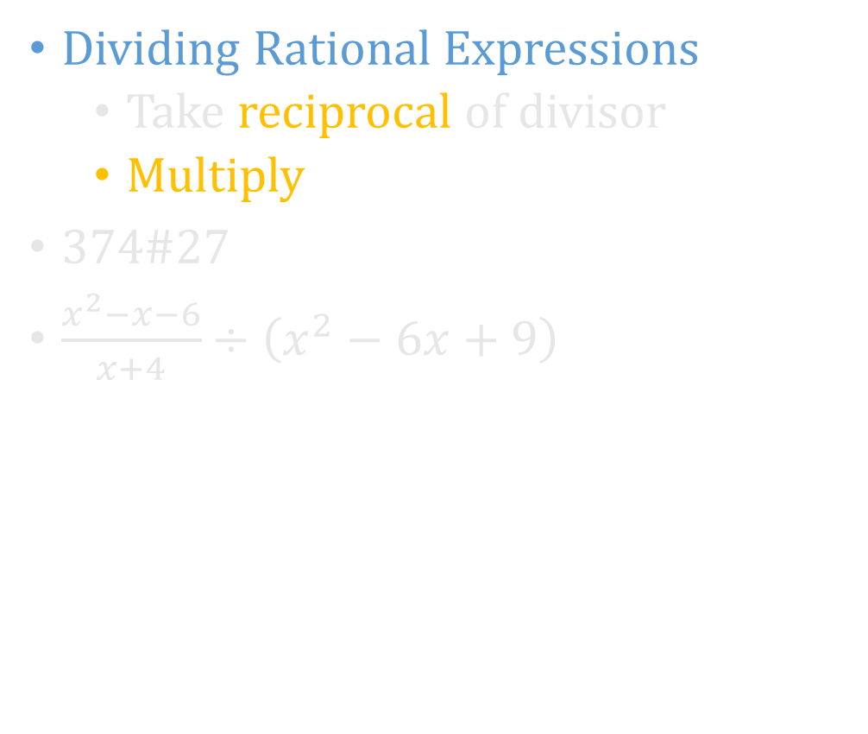

7.3 Multiplying and Dividing
Rational Expressions
Dividing Rational Expressions
  Take reciprocal of divisor
  Multiply
374#27
$\frac{x^{2}−x−6}{x+4}÷\left(x^{2}−6x+9\right)$
Try 374#25
$\frac{x^{2}−x−6}{2x^{4}−6x^{3}}÷\frac{x+2}{4x^{3}}$
Notes:
$$\frac{x^{2}−x−6}{x+4}·\frac{1}{x^{2}−6x+9}→\frac{\left(x−3\right)\left(x+2\right)}{\left(x+4\right)}·\frac{1}{\left(x−3\right)\left(x−3\right)}→\frac{x+2}{\left(x+4\right)\left(x−3\right)}$$
$$\frac{x^{2}−x−6}{2x^{4}−6x^{3}}·\frac{4x^{3}}{x+2}→\frac{\left(x−3\right)\left(x+2\right)}{2x^{3}\left(x−3\right)}·\frac{4x^{3}}{x+2}→2$$

Slide 24
7.3 Multiplying and Dividing
Rational Expressions
Combined Operations
  Do the first two operations
  Use that result with the next operation
374 #1, 5, 7, 9, 11, 13, 15, 17, 19, 23, 25, 27, 29, 31, 33, 43, 45, 47, 49, 55

Slide 25
7.4 Adding and Subtracting
Rational Expressions
After this lesson…
• I can add and subtract rational expressions with like denominators.
• I can explain how to find a common denominator for rational expressions.
• I can add and subtract rational expressions with unlike denominators.

Slide 26

7.4 Adding and Subtracting
Rational Expressions
Work with a partner.
a. Explain how to find each sum or difference.
i. $\frac{3}{8}+\frac{1}{8}$
ii. $\frac{9}{10}−\frac{3}{10}$
iii. $\frac{1}{2}+\frac{3}{4}$
iv. $\frac{5}{8}−\frac{7}{12}$

Slide 27
7.4 Adding and Subtracting
Rational Expressions
Adding and Subtracting
  Need least common denominator (LCD)
    If LCD already present, add or subtract numerators only
  To get fractions with LCD
    Factor all denominators
    LCD is the product of the highest power of each factor in either expression
    Whatever you multiply the denominator by, multiply the numerator also

Slide 28


7.4 Adding and Subtracting
Rational Expressions
382#9
Find the least common multiple of $5x$ and $5x−10$.
Try 382#11
$2x^{2}−18, x^{2}+x−12$
Notes:
$$5x=5·x$$
$$5x−10=5·(x−2)$$
LCM: $5·x·\left(x−2\right)=5x\left(x−2\right)$
$$2x^{2}−18=2\left(x^{2}−9\right)=2\left(x−3\right)\left(x+3\right)$$
$$x^{2}+x−12=\left(x+4\right)\left(x−3\right)$$
LCM: $2(x−3)(x+3)(x+4)$

Slide 29


7.4 Adding and Subtracting
Rational Expressions
382#1
$\frac{15}{4x}+\frac{5}{4x}$
Try 382#5
$\frac{5x}{x+3}+\frac{15}{x+3}$
Notes:
$$\frac{20}{4x} → \frac{5}{x}$$
$$\frac{5x+15}{x+3}→\frac{5\left(x+3\right)}{x+3}→5$$

Slide 30


7.4 Adding and Subtracting
Rational Expressions
382#19
$\frac{12}{x^{2}+5x−24}+\frac{3}{x−3}$
Try 382#17
$\frac{3}{x+4}−\frac{1}{x+6}$
Notes:
$$\frac{12}{\left(x−3\right)\left(x+8\right)}+\frac{3}{x−3}→\frac{12}{\left(x−3\right)\left(x+8\right)}+\frac{3\left(x+8\right)}{\left(x−3\right)\left(x+8\right)}→\frac{12}{\left(x−3\right)\left(x+8\right)}+\frac{3x+24}{\left(x−3\right)\left(x+8\right)}→\frac{3x+36}{\left(x−3\right)\left(x+8\right)}→\frac{3\left(x+12\right)}{\left(x−3\right)\left(x+8\right)}$$
$$\frac{3}{x+4}−\frac{1}{x+6}→\frac{3\left(x+6\right)}{\left(x+4\right)\left(x+6\right)}−\frac{1\left(x+4\right)}{\left(x+4\right)\left(x+6\right)}→\frac{3x+18}{\left(x+4\right)\left(x+6\right)}−\frac{x+4}{\left(x+4\right)\left(x+6\right)}→\frac{2x+14}{\left(x+4\right)\left(x+6\right)}→\frac{2\left(x+7\right)}{\left(x+4\right)\left(x+6\right)}$$

Slide 31
7.4 Adding and Subtracting
Rational Expressions
Simplifying Complex Fractions
  Fractions within fractions
  Follow order of operations (groups first)
  Divide

Slide 32


7.4 Adding and Subtracting
Rational Expressions
382#39
$\frac{\frac{1}{3x^{2}−3}}{\frac{5}{x+1}−\frac{x+4}{x^{2}−3x−4}}$
382 #1, 5, 7, 9, 11, 13, 15, 17, 19, 20, 21, 23, 35, 39, 41, 55, 57, 59, 61, 65
Try 382#35
$\frac{\frac{x}{3}−6}{10+\frac{4}{x}}$
Notes:
$$\frac{\frac{1}{3x^{2}−3}}{\frac{5}{x+1}−\frac{x+4}{x^{2}−3x−4}}→\frac{\frac{1}{3\left(x−1\right)\left(x+1\right)}}{\frac{5}{x+1}−\frac{x+4}{\left(x−4\right)\left(x+1\right)}}→\frac{\frac{1}{3\left(x−1\right)\left(x+1\right)}}{\frac{5\left(x−4\right)}{\left(x−4\right)\left(x+1\right)}−\frac{x+4}{\left(x−4\right)\left(x+1\right)}}→\frac{\frac{1}{3\left(x−1\right)\left(x+1\right)}}{\frac{5x−20}{\left(x−4\right)\left(x+1\right)}−\frac{x+4}{\left(x−4\right)\left(x+1\right)}}→\frac{\frac{1}{3\left(x−1\right)\left(x+1\right)}}{\frac{4x−24}{\left(x−4\right)\left(x+1\right)}}→\frac{\frac{1}{3\left(x−1\right)\left(x+1\right)}}{\frac{4\left(x−6\right)}{\left(x−4\right)\left(x+1\right)}}→\frac{1}{3\left(x−1\right)\left(x+1\right)}·\frac{\left(x−4\right)\left(x+1\right)}{4\left(x−6\right)}→\frac{x−4}{12\left(x−1\right)\left(x−6\right)}$$
$$\frac{\frac{x}{3}−6}{10+\frac{4}{x}}→\frac{\frac{x}{3}−\frac{18}{3}}{\frac{10x}{x}+\frac{4}{x}}→\frac{\frac{x−18}{3}}{\frac{10x+4}{x}}→\frac{\frac{x−18}{3}}{\frac{2\left(5x+2\right)}{x}}→\frac{x−18}{3}·\frac{x}{2\left(5x+2\right)}→\frac{x\left(x−18\right)}{6\left(5x+2\right)}$$

Slide 33
7.5 Solving Rational Equations
After this lesson…
• I can solve rational equations by cross multiplying and by using least common denominators.
• I can identify extraneous solutions of rational equations.
• I can solve real-life problems using inverses of rational functions.

Slide 34

7.5 Solving Rational Equations
Work with a partner.
a. Match each equation with its related graph. Explain your reasoning. Then use the graph to approximate the solution(s) of the equation.
i. $\frac{2}{x−1}=1$ ii. $\frac{−x−1}{x−3}=x+1$ iii. $\frac{1}{x}=\frac{−1}{x−2}$

Slide 35
7.5 Solving Rational Equations
Only when the = sign is present!!!
Method 1: simplify both sides and cross multiply
Method 2:
Multiply both sides by LCD to remove fractions
Solve
Check answers

Slide 36


7.5 Solving Rational Equations
390#5
$\frac{x}{2x+7}=\frac{x−5}{x−1}$
390#1
$\frac{4}{2x}=\frac{5}{x+6}$
Notes:
Cross multiply
$$x\left(x−1\right)=\left(2x+7\right)\left(x−5\right)→x^{2}−x=2x^{2}−3x−35→0=x^{2}−2x−35→0=\left(x−7\right)\left(x+5\right)→x=7, −5$$
$$10x = 4\left(x+6\right)→10x=4x+24→6x=24→x=4$$

Slide 37


7.5 Solving Rational Equations
390#21
$\frac{6x}{x+4}+4=\frac{2x+2}{x−1}$
Try 390#17
$\frac{3}{2}+\frac{1}{x}=2$
Notes:
$$\frac{6x\left(x−1\right)\left(x+4\right)}{x+4}+4\left(x−1\right)\left(x+4\right)=\frac{\left(2x+2\right)\left(x−1\right)\left(x+4\right)}{x−1}→6x\left(x−1\right)+4\left(x−1\right)\left(x+4\right)=\left(2x+2\right)\left(x+4\right)→6x^{2}−6x+4x^{2}+12x−16=2x^{2}+10x+8→8x^{2}−4x−24=0→4\left(2x^{2}−x−6\right)=0→4\left(2x+3\right)\left(x−2\right)=0→x=−\frac{3}{2},2$$
$$\frac{3}{2}+\frac{1}{x}=2→\frac{3\left(2x\right)}{2}+\frac{1\left(2x\right)}{x}=2\left(2x\right)→3x+2=4x→2=x$$

Slide 38
7.5 Solving Rational Equations
Determine if the inverse of a function is a function
  Graph the function
  If any horizontal line touches the graph more than once, then the inverse is not a function
Finding Inverse of Rational Functions
  Switch x and y
  Solve for y

Slide 39
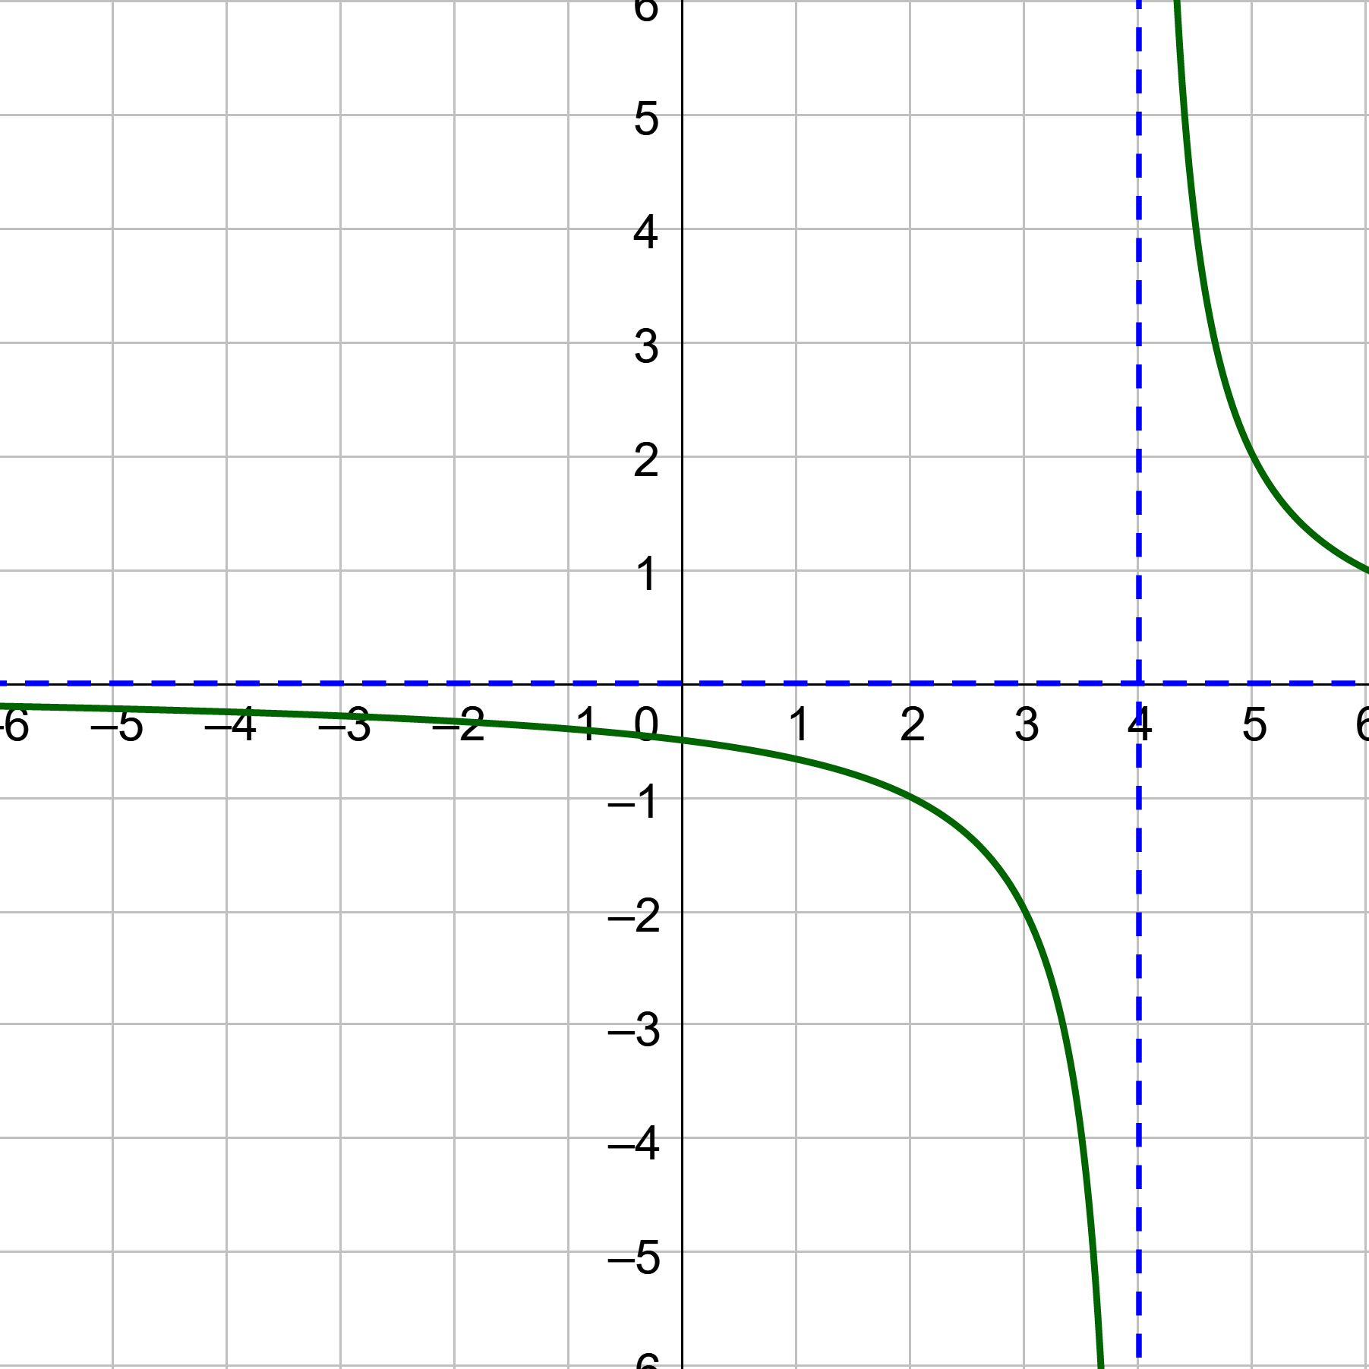
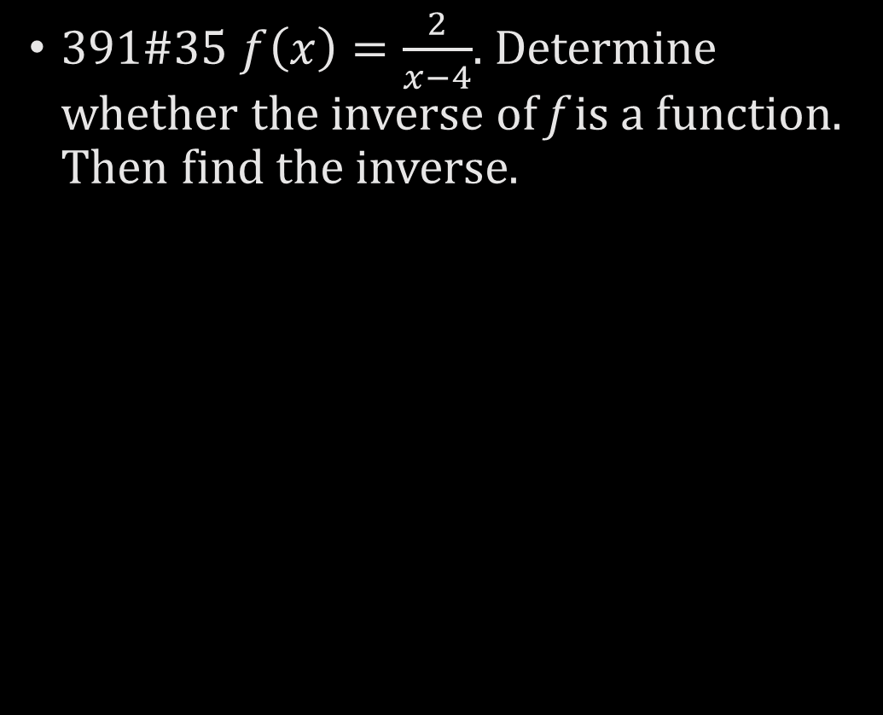
7.5 Solving Rational Equations
391#35 $f\left(x\right)=\frac{2}{x−4}$. Determine whether the inverse of f is a function. Then find the inverse.
Notes:
The graph passes the horizontal line test, so the inverse is a function
$$y=\frac{2}{x−4}$$
Switch x and y
$$x=\frac{2}{y−4}$$
Solve for y
$$\left(y−4\right)x=2$$
$$y−4=\frac{2}{x}$$
$$y=\frac{2}{x}+4$$

Slide 40
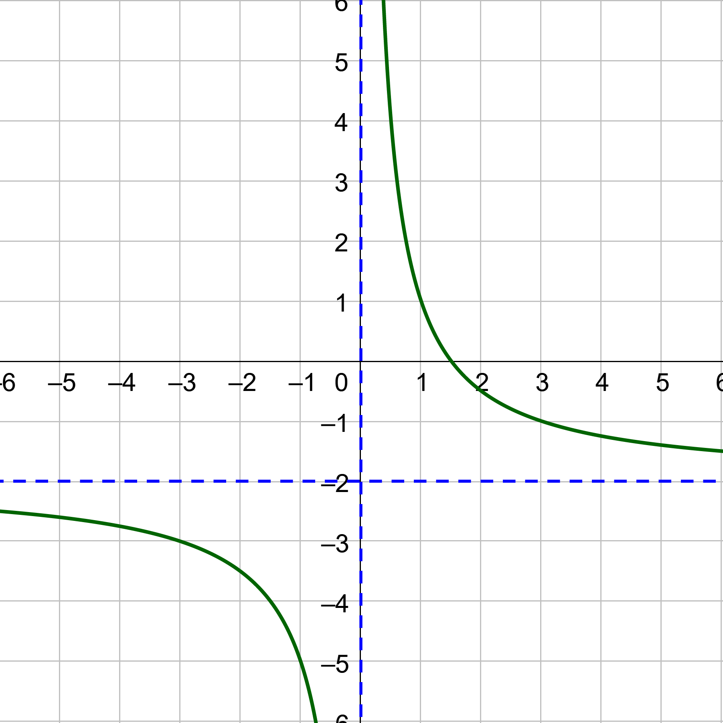

7.5 Solving Rational Equations
Try 391#37 $f\left(x\right)=\frac{3}{x}−2$. Determine whether the inverse of f is a function. Then find the inverse.
390 #1, 5, 11, 13, 15, 17, 19, 21, 23, 25, 27, 29, 35, 37, 39, 57, 59, 61, 63, 65
Notes:
The graph passes the horizontal line test, so the inverse is a function
$$y=\frac{3}{x}−2$$
Switch x and y
$$x=\frac{3}{y}−2$$
Solve for y
$$x+2=\frac{3}{y}$$
$$y\left(x+2\right)=3$$
$$y=\frac{3}{x+2}$$

